Slide 1
Coleridge’s Definitions of Prose and Poetry
“I wish our clever young poets would remember my homely definitions of prose and poetry; that is, prose — words in their best order; poetry — the best words in their best order.”
- Samuel Taylor Coleridge

Slide 2
Found Poetry
Found poetry is a type of poetry created by taking words, phrases, and sometimes whole passages from other sources and reframing them as poetry (a literary equivalent of a collage) by making changes in spacing and lines, or by adding or deleting text, thus imparting new meaning.

Slide 3
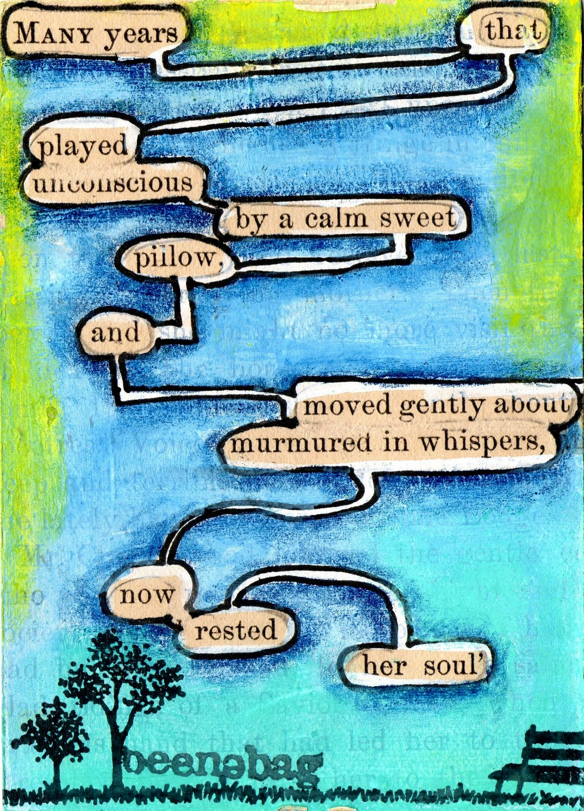

Slide 4
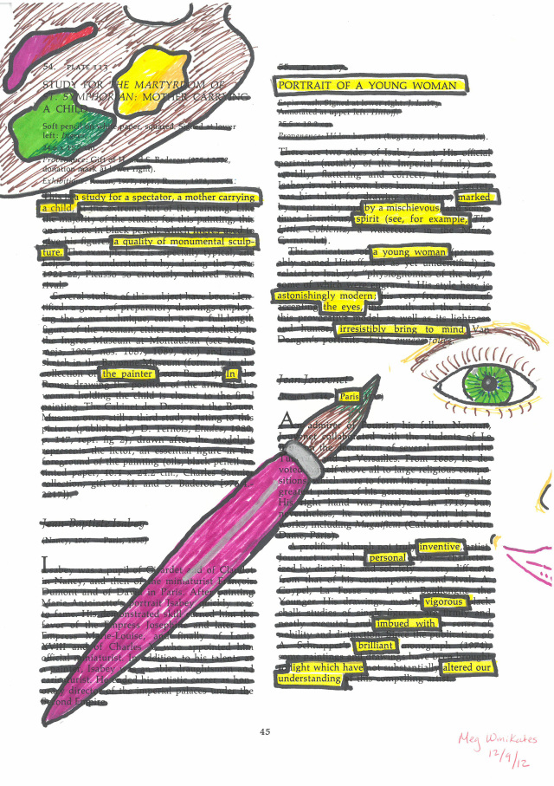

Slide 5
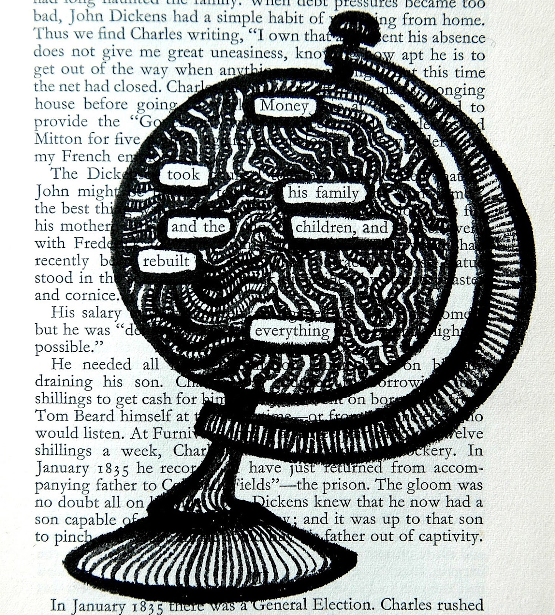

Slide 6
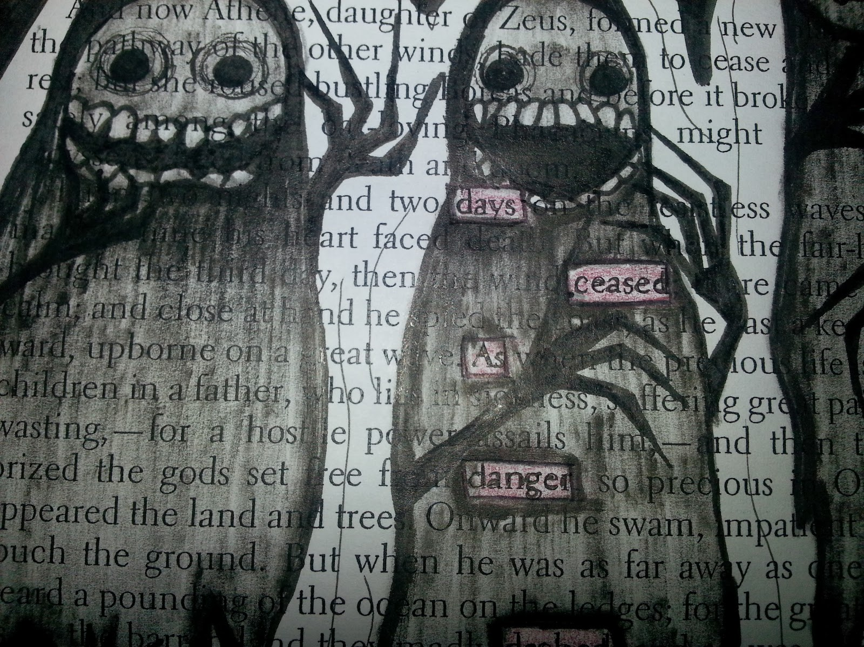

Slide 7
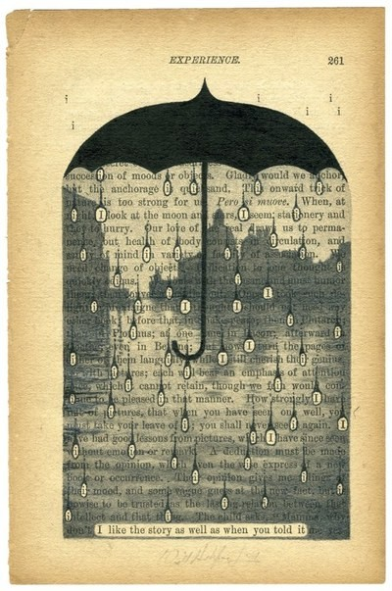

Slide 8
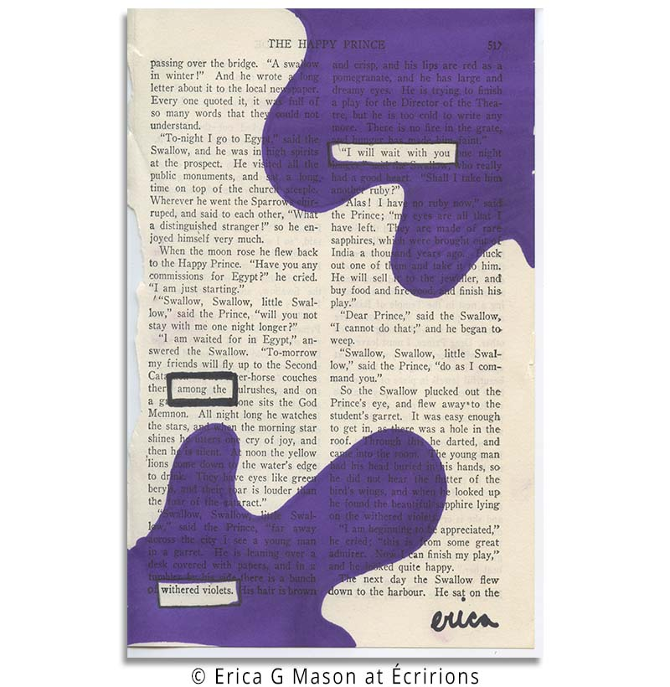

Slide 9
