Slide 1
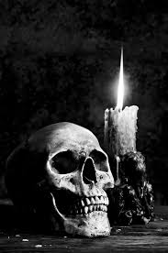
Gothic Architecture
What do you think of when you see/hear the word ‘gothic’?

Slide 2
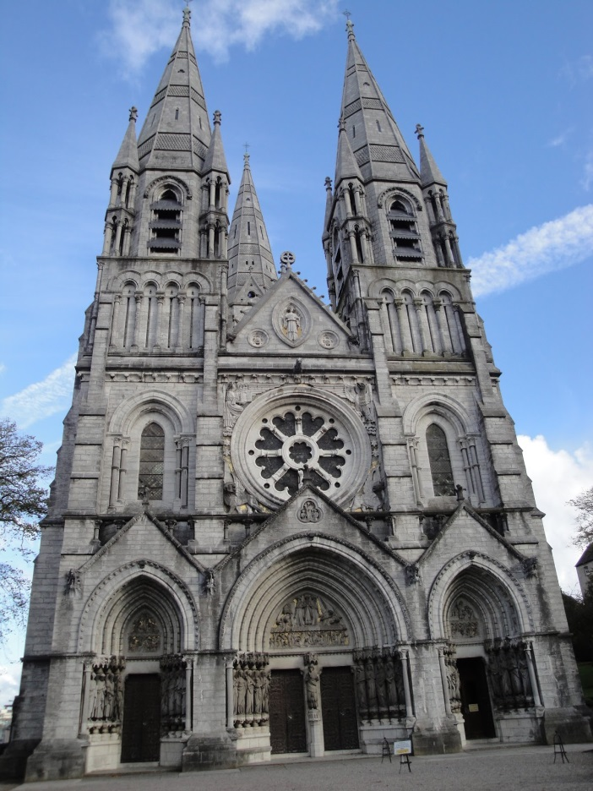
Is this the same as you thought?

Slide 3
research time!
Go to http://www.exploring-castles.com/characteristics_of_gothic_architecture.html to answer the following questions
When was gothic architecture popular? Why?
What would Medieval people call their architecture?
What are the 7 characteristics of gothic architecture?
Where did the name ‘gothic’ come from? Why did this have negative connotations?

Slide 4
Sagrada Familia
After watching the videos on the Sagrada Familia, discuss these questions with a partner:
when was it constructed?
why and how is the architecture important?
what similarities are there with typical gothic architecture?

