Slide 1
The American Revolution
1775(65) - 1783

Slide 2
“Death and Taxes”
Several famous authors have uttered lines to this effect. The first was Daniel Defoe, in The Political History of the Devil, 1726:
"Things as certain as death and taxes, can be more firmly believed."
Benjamin Franklin (1706-90) used the form we are currently more familiar with, in a letter to Jean-Baptiste Leroy, 1789, which was re-printed in The Works of Benjamin Franklin, 1817:
"'In this world nothing can be said to be certain, except death and taxes."
Another thought on the theme of death and taxes is Margaret Mitchell's line from her book Gone With the Wind, 1936:
"Death, taxes and childbirth! There's never any convenient time for any of them."

Slide 3
Crash Course!
What was the role of taxes?
What was the role of smuggling?
What sort of ‘representation’ did Americans want?
Did everyone want independence? Why?
What’s one other interesting fact?
Let’s finish the packet of primary and secondary sources

Slide 4
Affected by the Stamp act: internal taxation
Legal documents, ship’s papers, wills, licenses, newspapers, pamphlets, advertisement, bills of sale, almanacs, calendars, any kind of declarations, pleas to courts, donations, inventory, testimonials, diplomas and certificates of university, college, seminary or academy of learning; affidavits, bails, business license, writ of covenant for levying of fines, writ of entry for suffering a common recovery, court orders, dice and playing cards among others.
Which items seem logical to have a tax? Which don’t?

Slide 5
Other things Americans were upset about
Background:
The Fall of Quebec (1759/60)
Treaty of Paris (1763)
Spain gets Louisiana and New Orleans (city)
France gets St. Pierre and Miquelon (islands off NFL), and Caribbean islands (Martinique, Guadaloupe)
Quebec came under military rule
The Royal Proclamation (1763) and the Quebec Act (1774)

Slide 6
The Royal proclamation, 1763
Treatment to the French Canadians was relatively fair under the first Br governor Guy Carleton (paid for things, guns for hunting, kept jobs)
After 1763, French fur traders left, creating a vacuum
Montrealers (Scottish and British) push west and create the North West Company
Native people protest to British (1763), but Scottish traders (British parliament) + land speculators
Pontiac, Ottawa chief, wants to build a larger nation in the Interior

Slide 7
First Nation Resistance
Many First Nations were not happy with the result of the Seven Years’ War
French fur traders encouraged them join them in resisting British rule
FN leaders knew that British and American traders and settlers would threaten their land and way of life
Pontiac, great Chief of the Ottawa Nation, united several tribes and waged war against the British

Slide 8
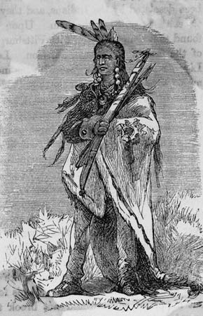
Pontiac
Ottawa Chief Pontiac led history’s most successful war against Europeans by Aboriginal peoples in North America
Eventually, he was killed and a peace was agreed upon, but this directly led to King George III of Britain issuing The Royal Proclamation of 1763
Examine info packet!

Slide 9
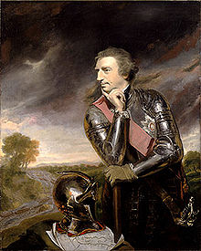
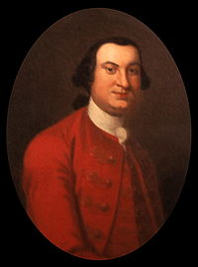
Germ Warfare: smallpox blankets
Sir Jeffery Amherst to Colonel Henry Bouquet:
'Could it not be contrived to send smallpox among these disaffected tribes of Indians? We must use every stratagem in our power to reduce them.'
Bouquet’s response:
'I will try to inoculate the [Native American tribe] with some blankets that may fall in their hands, and take care not to get the disease myself.'
INVESTIGATE ONLINE: What is chemical warfare? Is it legal in warfare nowadays? Why?

Slide 10
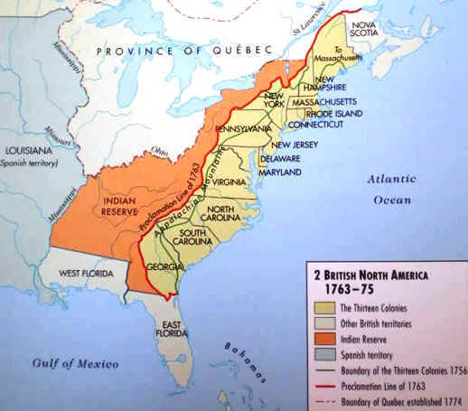
The Royal Proclamation, 1763
AFTER Pontiac’s defeat, the king issued a Royal Proclamation
No land speculation west of Appalachian Mtns.
I.e. no OHIO VALLEY
It also explicitly states:
“Aboriginal Title” (ownership) of land existed before, and continues to exist
The right to aboriginal “self-determination” (the right to be in charge of themselves)
POV of Americans: best interest? less important? Angry.

Slide 11
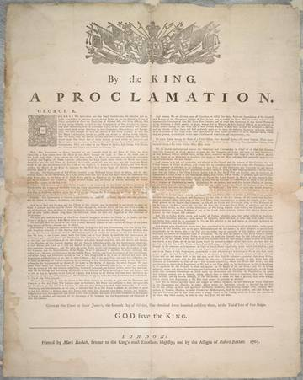
The Royal Proclamation, 1763
The Royal Proclamation has been referenced even recently in land negotiations between the Canadian government and Aboriginal peoples.
Key Question:
Is the Royal Proclamation the source of Aboriginal land rights, or does it merely acknowledge and confirm its pre-existence?

Slide 12
Quebec
Quebec was essentially under military rule by Britain
Britain had hoped Quebecers would forget their language and traditions and assimilate into British culture
Many wealthy and important French fur traders left for France or New Orleans. They were replaced by Scottish and American fur traders (they would become the Northwest Company)
The French would hold on dearly to their language and culture

Slide 13
The Quebec Act, 1774
As a result, Quebec would become a new British territory
so the British don’t have to maintain military rule
The Canadiens in Quebec hoped to have their rights and customs respected, and also more democracy - they wanted an elected assembly like the 13 American colonies
But the Quebec Act kept the feudal system of the church and seigneurs (land owners)
It promised to recognize the Catholic Church and blend English criminal law and French civil law

Slide 14
The Quebec Act, 1774
But the secret plan was to suppress the Catholic Church and replace French civil law with English civil law
Quebecers hoped they would get an elected assembly like the 13 American colonies had, but instead they were under the thumb of the British Monarchy

Slide 15
The Quebec act, 1774
The Americans hated the Quebec Act as well. The Act expanded Quebec territory into the Ohio valley.
They wanted to expand into the Ohio Valley, but were now prevented from doing so.
Quebec didn’t have an elected assembly, and the American 13 colonies felt threatened by this (maybe it would happen to them?)
This would lead directly to the American Revolution

Slide 17
British motivations?
What do these events reveal about British motivations?
Are these motivations different from the ones during the 7 Years’ War?

Slide 18
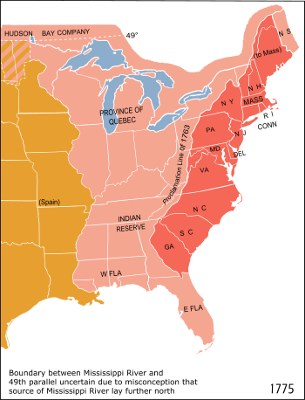
Lead up to the revolution
Last class we learned:
The Royal Proclamation and the Quebec Act defined the borders of the Province of Quebec (now a British colony) and “Indian” territory
This angered the
13 Colonies as it blocked expansion (especially into the Ohio Valley)

Slide 19
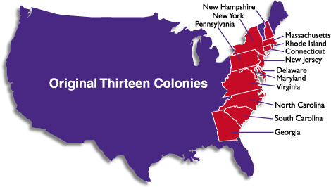

Slide 20
The 13 colonies
The 13 Colonies were upset about being taxed by Britain, without having any representation in British parliament: “Taxation without representation”
The felt like they were being treated like 2nd class citizens
The colonies were not united; they each had their own legislature and strong business ties with Britain

Slide 21
The Sons of liberty & the stamp act
A group called “The Sons of Liberty” was formed to intimidate English officers who tried to enforce the tax
The Stamp Act, and all others except a tax on tea, were abolished
Other groups fighting against the English adopted the name of “The Sons of Liberty”

Slide 22
The boston massacre
In 1770, an angry mob of protesters in Boston began hurling rocks and snowballs at British soldiers
The soldiers fired into the crowd, killing 5 people
Video break!
What bias exists? How is the massacre presented? What motivations exist?

Slide 23
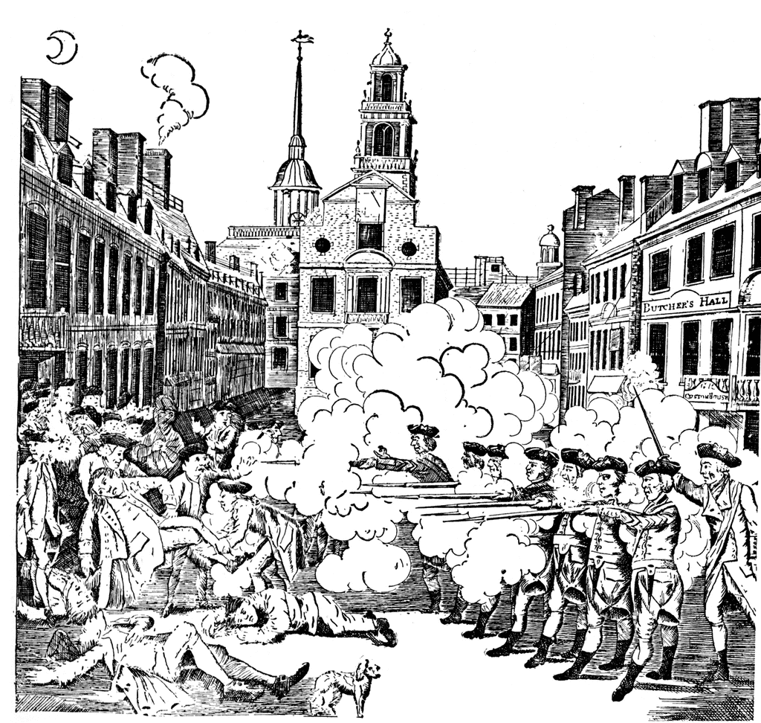

Slide 24
The boston tea party
In 1773, England passed “Tea Act” which gave the British East India Company a monopoly over tea sales in the colony
50 Sons of Liberty, dressed as Native Americans from the Mohawk tribe, threw 342 chests of tea into the ocean
This act has become a major symbol for the American resistance to British rule leading up to the War of Independance

Slide 25
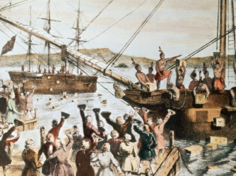

Slide 26
The first continental congress
When the Quebec Act was passed, the 13 colonies sent delegates to the “The First Continental Congress” in Philadelphia
The delegates demanded a boycott of all goods from England
British General Gage readied thousands of troops in Boston, and the revolutionary American forces began to train
The War of Independence was about to begin...

Slide 27
The Intolerable Acts
Research Time: Look up “The Intolerable Acts”.
What were they?
Briefly summarize each “Act”

Slide 28
Assassins creed
How is history presented in popular culture?
Why do we like to re-imagine what happened?
Would you be like the character in Assassin’s Creed and go back to change history? Why or why not? (this doesn’t necessitate that you assassinate people)

Slide 29
The Revolution Begins
drawn by Benjamin Franklin and first published in his Pennsylvania Gazette on May 9, 1754

Slide 30
Who needs convincing?
Let’s take a look at some primary (and secondary sources) from:
Thomas Paine (1776)
AND
Patrick Henry (1775)
Think: Why would people need to be convinced?

Slide 31
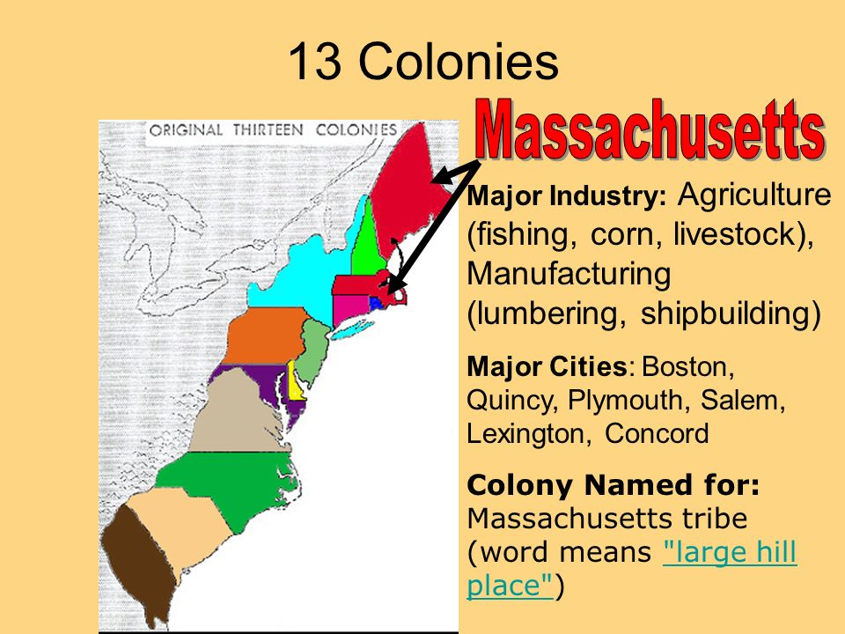
Battles of Lexington and Concord
The first battles of the American Revolution took place April 19th, 1775, in Massachusetts

Slide 32
The Shot Heard Round the World
At Lexington Green, British and American soldiers faced off, and Americans allegedly fired first.
This became known as “The Shot Heard Round the World” (many other shots were fired earlier that day)
It was however:
The first organized volley by the Americans
The first British Casualties
The First British retreat

Slide 33
Bias/Propaganda?
And School House Rock: Shot Heard ‘round the World

Slide 34
The Revolution Continues
The event told the King (George III) that the “rebellion” was real and under way.
Some English citizens sympathized with the Americans in their fight for democracy (England enjoyed more democratic freedoms than anyone after the English Civil War)
Colonial Leaders such as George Washington put together a sizeable army to go to war

Slide 35
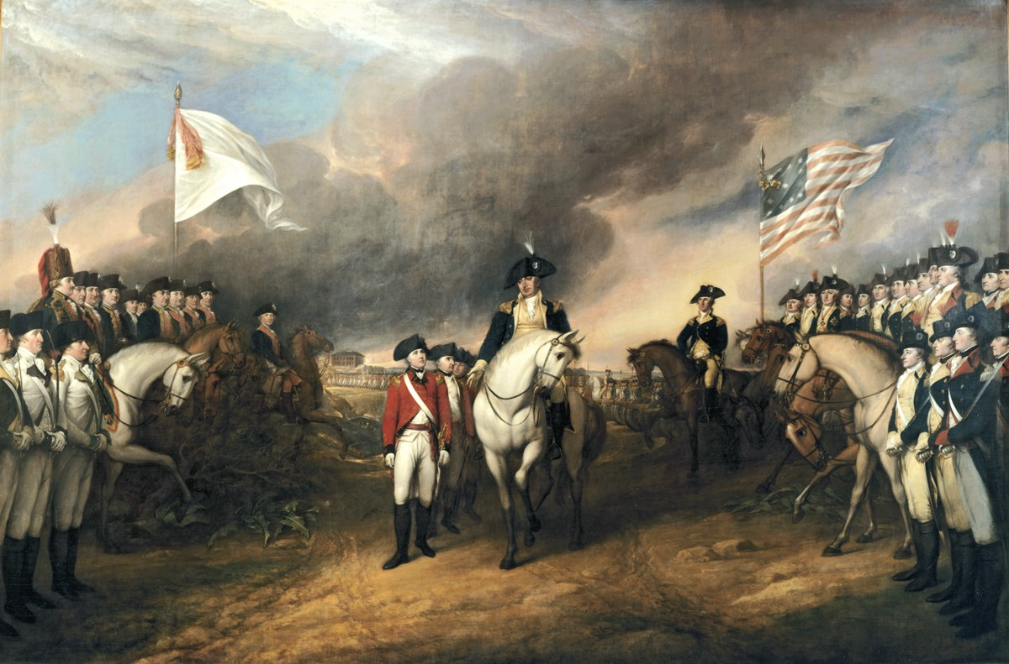
Analysis of George Washington

Slide 36
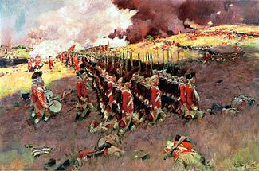
Battle at Bunker Hill, 1775
The first large-scale battle was near Bunker Hill in Boston.
The British army won, but suffered more casualties than the Americans
(about 1000 British casualties vs. 500 Americans)

Slide 37
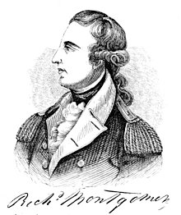
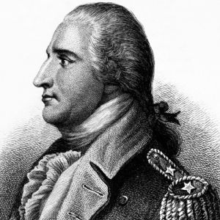
The Invasion of Quebec, 1775
Congress looked to defend the northern border, and thought that Quebec, Nova Scotia, and Newfoundland (British colonies) would join them
The invasion was led by General Richard Montgomery and General Benedict Arnold

Slide 38
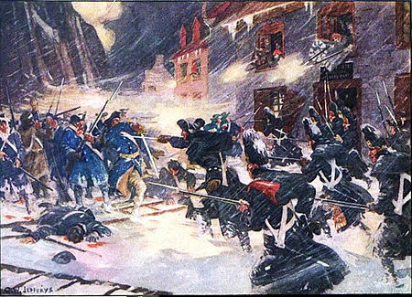
The Invasion of Quebec, 1775
In the winter of 1775, Montgomery and Arnold led their forces in a snowstorm to try to take Quebec.
Montgomery was killed, Arnold eventually had to retreat. The siege had failed .

Slide 39
Consequences of the Battle of Quebec
Some French Canadians helped the British hold the city, some gave support to the American
The city’s defense was helped by local French speaking militia, but some gave the Americans supplies and logistical support
The overall impact of the Battle of Quebec convinced most Canadians to stay loyal to Britain

Slide 40
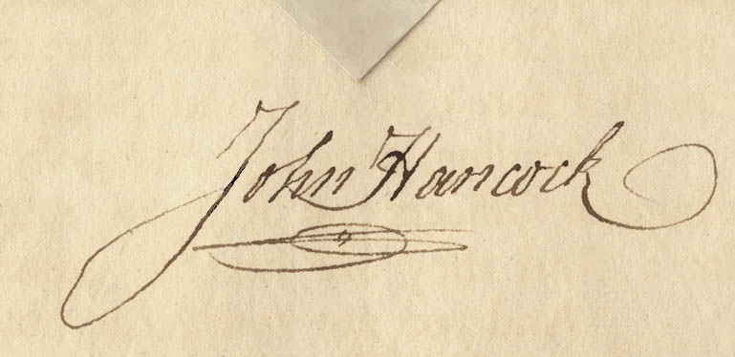
The Declaration of Independence, 1776
“We hold these truths to be self-evident, that all men are created equal, that they are endowed by their Creator with certain unalienable Rights, that among these are Life, Liberty and the pursuit of Happiness.”
This is the most famous line from the Declaration. This was the first signature
John Hancock,
President of Congress
More Analysis!
Document and Video

Slide 41
The Revolution… Succeeds!
George Washington and his continental army forced the British out of Boston in the Spring of 1776
The British amassed forces at Halifax, Nova Scotia
They took New York in the Battle of Brooklyn, and asked for a meeting with Congress leaders to end the fighting

Slide 42
The Staten Island Peace Conference, 1776
The British asked Congress to retract the Declaration of Independence at
“The Staten Island Peace Conference”
Congress refused, and the British nearly captured Washington’s army when it took control of New York City and later took New Jersey as well

Slide 43
The Crossing of the Delaware, 1776 (xmas)
Washington was pushed back into Pennsylvania, and the morale of the American Patriots was at low
He wanted to cross the Delaware River at 3 locations in a surprise attack (1 success)
He wasn’t able to gain much strategic territory, but took 1000 prisoners, muskets, gunpowder, and artillery
More importantly, the surprise attack became legendary, and boosted the moral of the American revolutionaries across the colonies

Slide 44
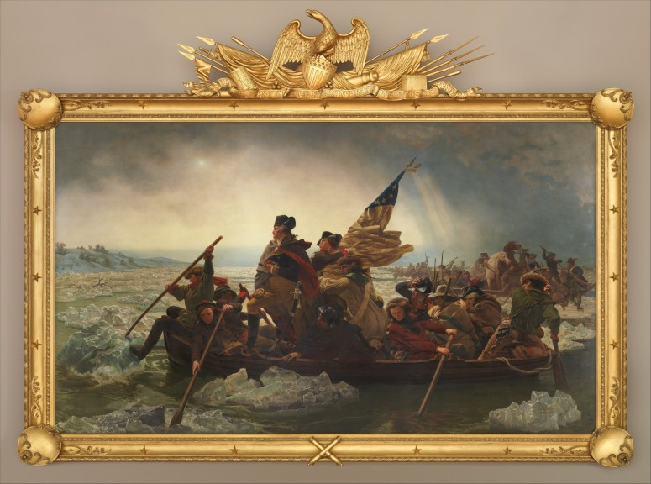

Slide 45
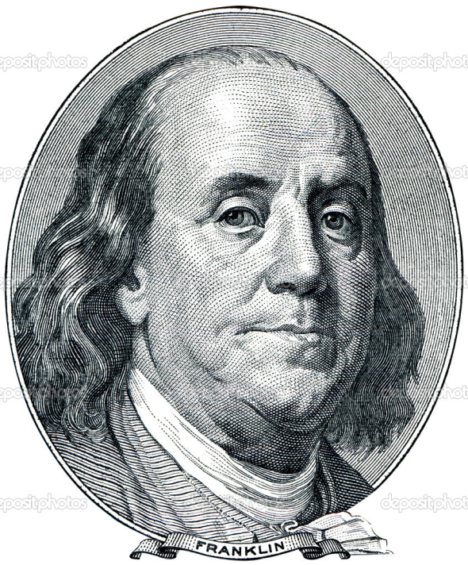
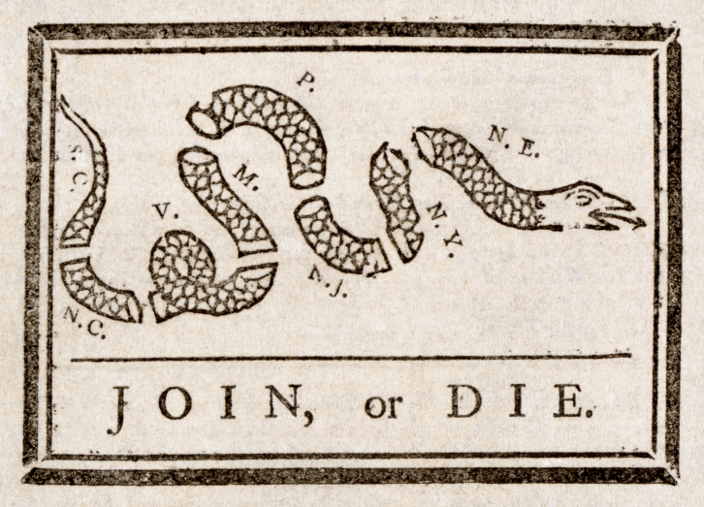
Les Amis!
The British suffered a major defeat at Saratoga (NY), and this inspired the French to formally join the Americans against the British
In 1778, Benjamin Franklin negotiated a treaty with the French, making France the first country to formally recognize the Declaration of Independence
Later, Spain and the Dutch would ally themselves with France, leaving Britain without major allies

Slide 46
U-S-A! U-S-A! Victory for the Americans
After more significant losses, the British Army under General Cornwallis marched to Yorktown, Virginia, where they expected to be rescued by British fleet
The fleet showed up, but so did a larger French fleet
Cornwallis had to surrender the army, effectively marking the overall defeat of the British -1781

Slide 48
Peace Negotiations
France intended to support American Independence, but not territorial gains
Britain, however saw an opportunity to make the US a valuable economic partner. The U.S.:
obtained all the land east of the Mississippi River, south of Canada, and north of Florida.
gained fishing rights off Canadian coasts,
agreed to allow British merchants and Loyalists to try to recover their property

Slide 49
Effect on British North America (Canada)
About 60,000 to 70,000 Loyalists left the newly founded republic; some migrated to Britain.
The rest, known as United Empire Loyalists, received land and in British colonies in North America, especially Quebec, Prince Edward Island, and Nova Scotia,
In Upper Canada (now Ontario) and New Brunswick land was awarded to Loyalists as compensation for losses in the United States.
Britain wanted to develop Upper Canada on a British colonial model.

Slide 50
Black Loyalists
Among these loyalist refugees were many African Americans who had been promised freedom if they fought on the British side
When British defeat became inevitable, the British Army evacuated more than 2000 Black Loyalists to Nova Scotia
Those left behind were recaptured into slavery in the US

Slide 51
Black Loyalists
Birchtown, Nova Scotia became the largest settlement of free blacks outside of Africa
However, most blacks never received the land or provisions the were promised and worked tough jobs for low wages, suffering from discrimination
Eventually, their situation improved and the felt part of the community enough to form 3 separate militia units to fight in the War of 1812

Slide 52
A Black Loyalist wood cutter, at Shelburne, Nova Scotia, in 1788

Slide 53
Women
I desire you would Remember the Ladies, and be more generous and favorable to them than your ancestors. Do not put such unlimited power into the hands of the Husbands. Remember all Men would be tyrants if they could. If particular care and attention is not paid to the Ladies we are determined to foment a Rebellion, and will not hold ourselves bound by any laws in which we have no voice, or Representation.
Abigail Adams to John Adams, March 31, 1776

Slide 54
As to your extraordinary Code of Laws, I cannot but laugh. We have been told that our Struggle has loosened the bands of Government every where. That Children and Apprentices were disobedient—that schools and Colleges were grown turbulent—that Indians slighted their Guardians and Negroes grew insolent to their Masters. But your Letter was the first Intimation that another Tribe more numerous and powerful than all the rest were grown discontented. . . .
Depend upon it, We know better than to repeal our Masculine systems. Although they are in full Force, you know they are little more than Theory. We dare not exert our Power in its full Latitude. We are obliged to go fair, and softly, and in Practice you know We are the subjects. We have only the Name of Masters, and rather than give up this, which would completely subject Us to the Despotism of the Petticoat, I hope General Washington, and all our brave Heroes would fight.
John Adams to Abigail Adams, April 14, 1776

Slide 55
Poster assignment
With your group, create a comic of at least 10 boxes that shows the events of the American Revolution.
Include:
-title and dialogue
-causes and consequences
-sugar act, stamp act
-Royal Proclamation, Quebec Act, Pontiac
Sons of Liberty, Boston Massacre, Boston Tea Party
First Continental Congress, Intolerable Acts
Lexington Green, Bunker Hill, Invasion of Quebec, Delaware, Yorktown
Declaration of Independence; Staten Island Peace Conference, final peace conference
Black Loyalists and women

