Slide 1
The War of 1812!
America’s first declared war where nothing changed except for the number of casualties, (continued) Aboriginal suffering, and the need to paint the white house

Slide 2
Video: The Louisiana Purchase
President Thomas Jefferson’s (most important) achievement in 1803.
How long after the Treaty of Paris, which ended the American Revolution, was this?
Who did they make the purchase from?
How much land did they get?
How much did they pay? Why did they get a good price?
What do you think the land was like?
From: http://www.history.com/topics/louisiana-purchase

Slide 3
Video: Crash Course – War of 1812
What reasons were there for the War of 1812? (at least 3)
What was the role of the Aboriginal population?
Who was the Prophet?
How big was the US army/navy? The British?
How and why were the Canadians successful?
What happened at the Treaty of Ghent? What were the terms?
Why do Americans feel like they won?

Slide 4
Background to the War of 1812
Americans first tried to seize Quebec
They hoped they would join easily
BUT they have different cultures and it was unlikely that Americans would protect their language and culture; in the process of seizing Quebec, they paid Canadiens in worthless American currency
AND Americans could never hope to take the fortress of Quebec

Slide 5
The Loyalists
Approximately 1/5 of Americans were in favour of British rule
New immigrants
Sometimes called ‘Tories’
Patriots attacked, sometimes burning homes and farms

Slide 6
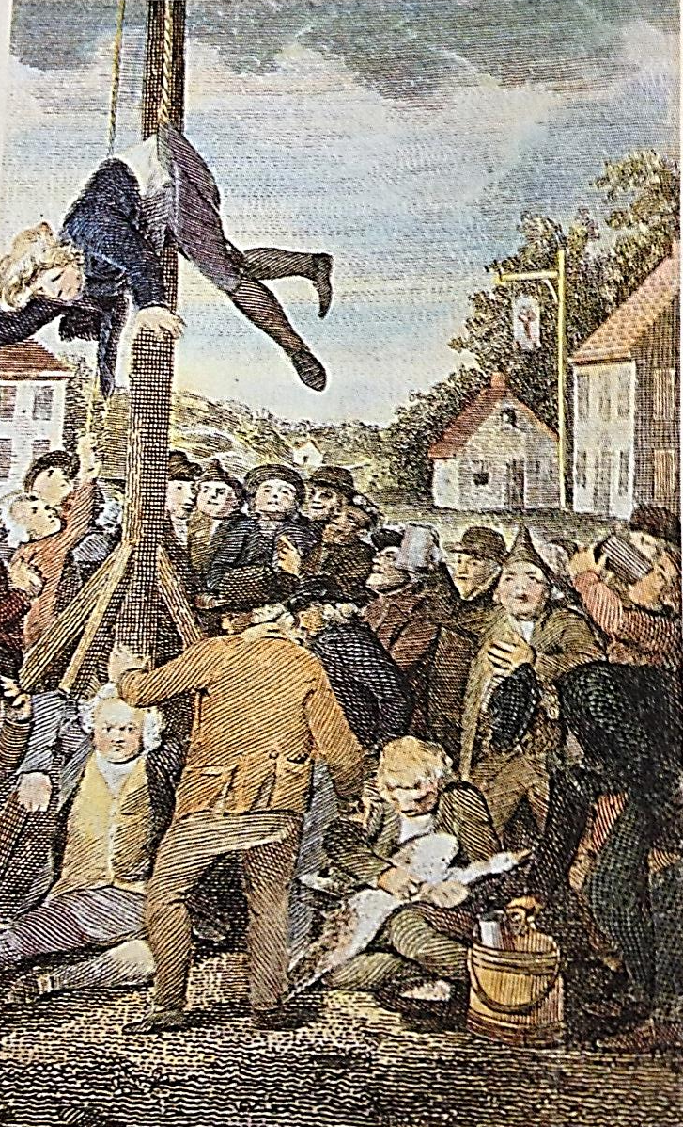
The Price of Loyalty
Americans who were loyal to the British government were often attacked and/or humiliated by rebels (Sons of Liberty)
Beaten
Tarred and feathered
Sometimes killed
Liberty poles

Slide 7
Primary Source: Boston Storekeeper
“It always seemed strange to me that people who (fight) so much for … liberty should be so ready to deprive others of their natural liberty; that men who are guarding against being subject to laws (to) which they never gave their consent in person or by their representative should at the same time make laws, and … execute them upon me and others, to which laws I am sure I never gave my consent either in person or by my representative.”
What contradiction is this storekeeper pointing out?

Slide 8
Arrival in Canada
Some Loyalists fought against Patriots in the south (civil war)
Many Loyalists went to Canada after
43,000 settled in Ontario; 8,000 in Maritimes – which created New Brunswick in 1784
The influx of more Anglo-phones created tension with the Franco-phones (60, 000)
Causes the division of Quebec
Upper Canada (West; Ontario) and Lower Canada (East; Quebec)

Slide 9
Joseph Brant and the Mohawks
Remember Tecumseh of the Shawnee Nation?
What did he do?
Joseph Brant from the Mohawk Nation
Acted as an ambassador for the Six Nations (Iroquois Confederacy)
Several trips to England (dining with royalty)
Highly respected
In time, Br gov’t gave land along Grand River, southern Ontario, to Mohawk nation
Mohawks allied with British in War of 1812

